Slide 1

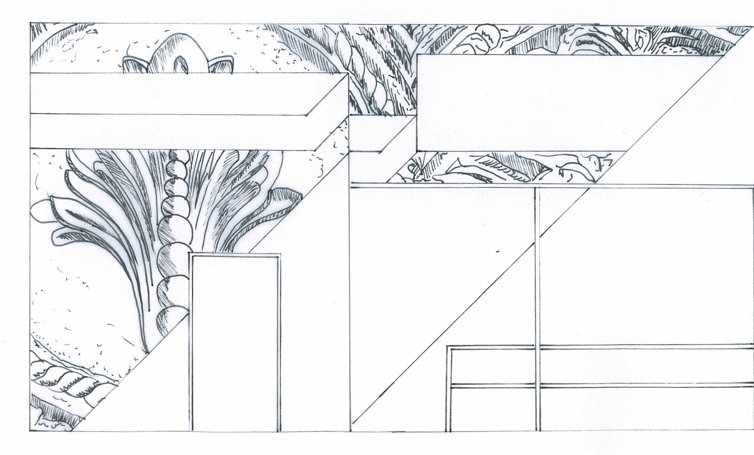
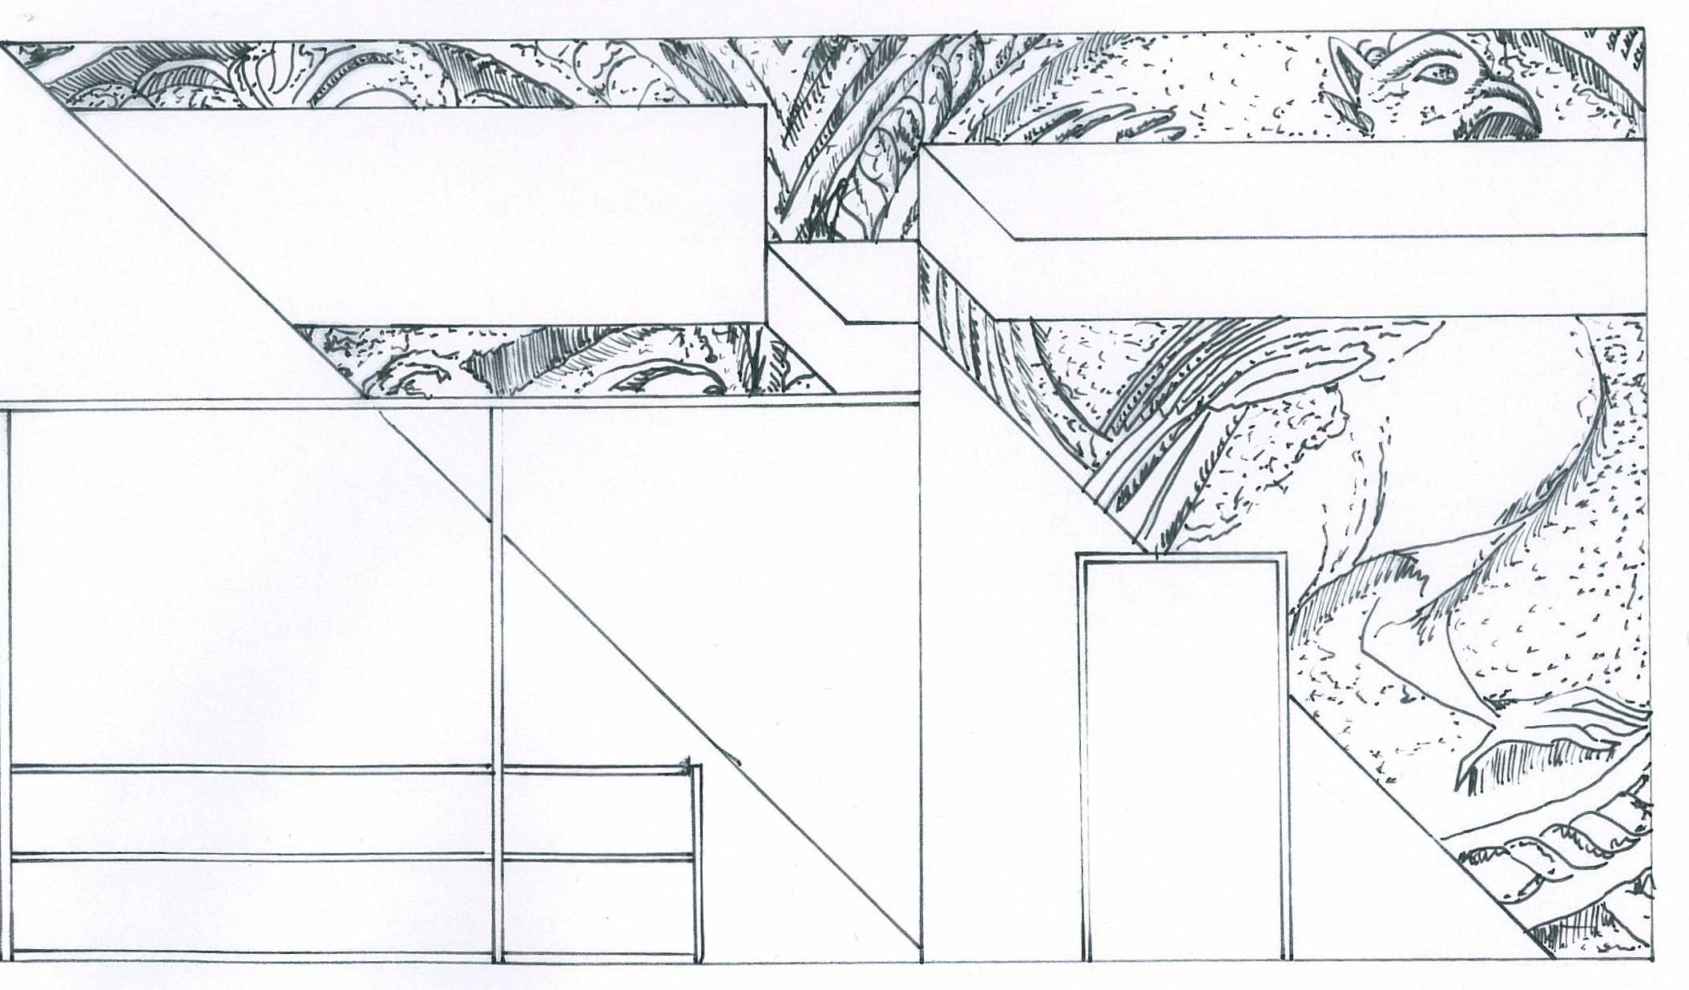

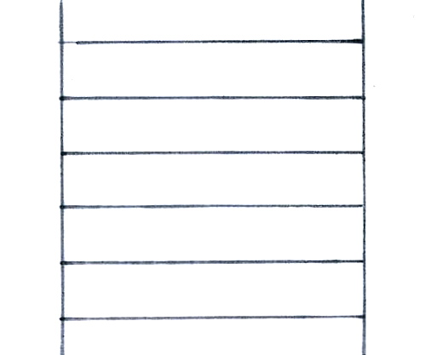
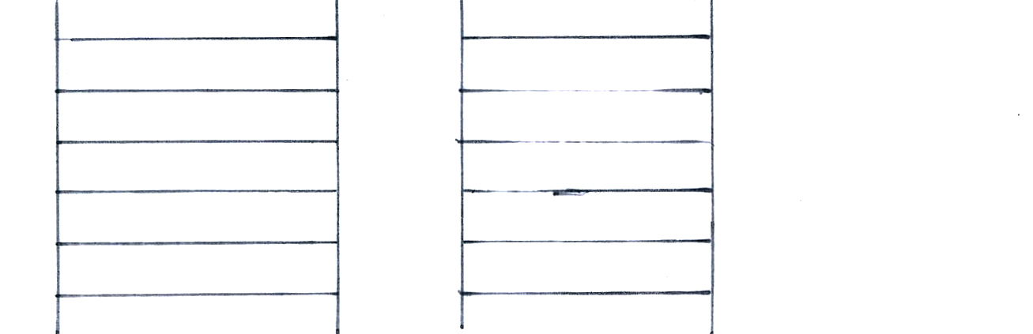
16,000mm
10,000mm
5,000mm
10,000mm
FRONT ELEVATION

Slide 2
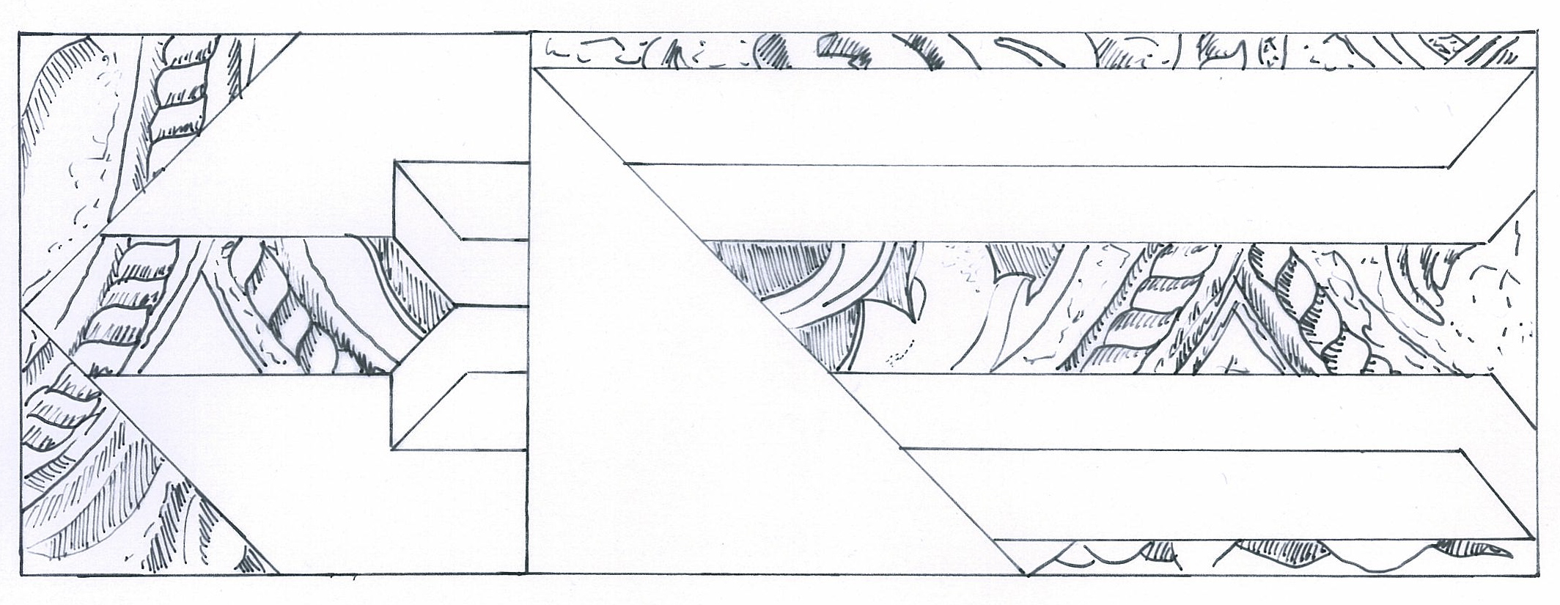
5,000mm
2,500mm
5,000mm
3,000mm
RIGHT AND LEFT
SIDE ELEVATIONS

Slide 3
FAÇADE MATERIALS KEY
1
High gloss / satin powder coated
aluminium sheet
2
Moulded fibre glass panels
Eggshell matt paint finish

Slide 4
2
2
1
1
1
1
2
2
1
1
1
1
MATERIALS
FRONT ELEVATION

Slide 5
1
1
2
2
1
1
1
MATERIALS
SIDE ELEVATIONS

Slide 6
A
A’
SECTION LINE A A’

Slide 7
FAÇADE MATERIALS
50mm
2
1
2
1
1
1
2
2
1
1
100mm
SECTION PERSPECTIVE A A’
SECTION ELEVATION A A’

